Slide 1
Negative Numbers
Chua Jian Rong (5)‏
Ho Chan Keen (9)‏
Lim Boon Choon (14)‏
Quek Yong Jian (20)‏

Slide 2
Introduction
What problems were Mathematicians trying to solve for which negative numbers were a useful tool?
Do negative numbers really exist in their own right, or could you argue that they are just a construct of mathematical notation?
What disputes where there in the past regarding negative numbers?
Where does most of our modern algebraic notation come from?

Slide 3
Negative numbers
A negative number is a number that is less than zero.
Example:
  -2
  -57
  -12183961942198274918629234566725094

Slide 4
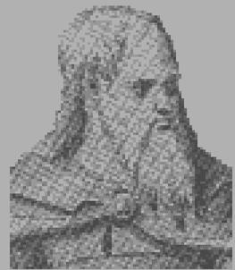
History of negative numbers
The first set of rules for dealing with negative numbers was stated in the 7th century by the Indian mathematician Brahmagupta who used the ideas of 'fortunes' and 'debts' for positive and negative.
Brahmagupta used a special sign for
  negatives and stated the rules for
  dealing with positive and negative
  quantities as follows:

Slide 5
A debt minus zero is a debt.
A fortune minus zero is a fortune.
Zero minus zero is a zero.
A debt subtracted from zero is a fortune.
A fortune subtracted from zero is a debt.
The product of zero multiplied by a debt or fortune is zero.
The product of zero multiplied by zero is zero.
The product or quotient of two fortunes is one fortune.
The product or quotient of two debts is one fortune.
The product or quotient of a debt and a fortune is a debt.
The product or quotient of a fortune and a debt is a debt
A debt – negative number
A fortune – positive number
Zero – 0
A debt is money owed

Slide 6
In translation:
A negative number minus zero is a debt
A positive number minus zero is a positive number
Zero minus zero is a zero
A negative number subtracted from zero is a positive number
A positive number subtracted from zero is a negative number
The product of zero multiplied by a negative number or positive number is zero
The product of zero multiplied by zero is zero
The product or quotient of two positive numbers is one positive number
The product or quotient of two negative numbers is one positive number
The product or quotient of a negative number and a positive number is a negative number
The product or quotient of a positive number and a negative number is a negative number

Slide 7




What problems were Mathematicians trying to solve for which negative numbers were a useful tool?
Temperature
Money management
Golf
Engineering
Velocity
Directions

Slide 8
Do negative numbers really exist in their own right, or could you argue that they are just a construct of mathematical notation?
They exist in their own right
  They are a key part of mathematics.
  As long as mathematics exists, negative numbers would exist also.

Slide 9
What disputes where there in the past regarding negative numbers?
There were issues on how multiplication would work on negative numbers.

Slide 10
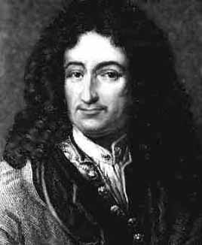
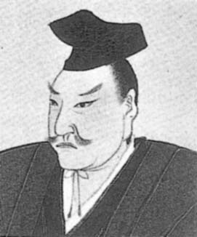
Where does most of our modern algebraic notation come from?
Gottfried Leibniz and Kowa Seki were the founders of many modern algebraic notations.

Slide 11
Acknowledgements
http://en.wikipedia.org/wiki/Negative_numbers
http://www.intmath.com/Numbers/1_Integers.php
http://math.nie.edu.sg/shutler/cam180.html
http://en.wikipedia.org/wiki/History_of_algebra

Slide 12
The End

